Slide 1
Food Insecurity and Obesity
By Sophia Harris, Sam McFarland, Esal Shakil, Nika Yermakova

Slide 2
Overview
01
04
02
05
03
Cluster Analysis
GitHub Update
Mediation Analysis
Next steps
Visualizations-

Slide 3
01
Cluster Analysis
Last week we followed an example cluster analysis. This week we ran it w/ our data.

Slide 4
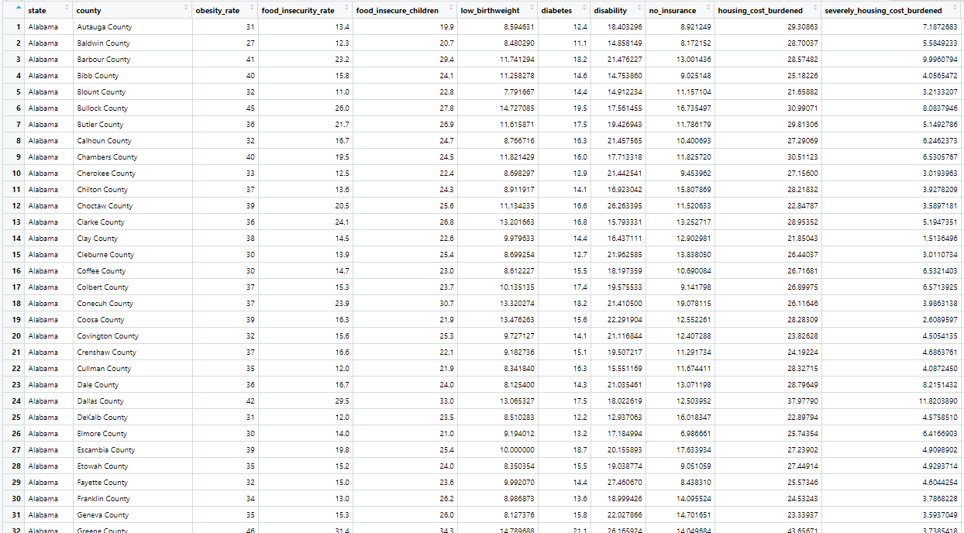
Cluster Analysis w/ Our Data
Here is a snippet of what our data looks like + the variables we have.
Obesity rates
Food insecurity rates
Food insecure children
Low birthweight
Diabetes
Disability
No insurance
Housing cost burden
Severely housing cost burden
Wage fair market rent
Median income
Below poverty
Unemployment
Credit score
Debt
Children
Seniors
People of color
Less than college education
Rural population

Slide 5
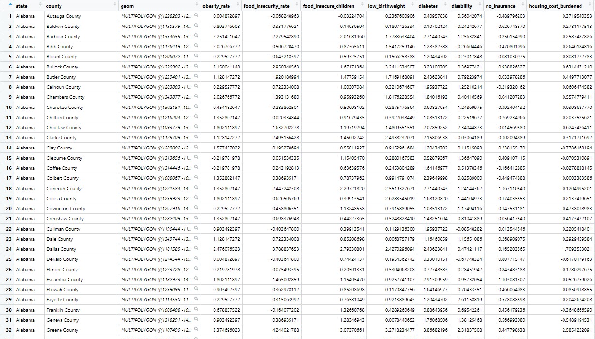
Cluster Analysis w/ Our Data
However, before we could start the clustering, we had to place all the observations on the same scale.
On this scale, 0 is the mean for that variable.
Now, instead of having a proportion or count, each observation will have a value to show how much it deviates from that mean.
Another thing we had to do was remove any NA values.
504 out 3,135 values were missing (roughly 16% of the data). So, now we have 2,913 counties to work with.

Slide 6
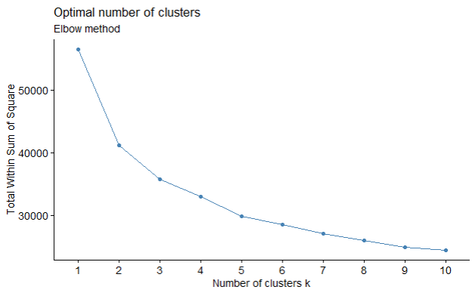
Cluster Analysis w/ Our Data
Using the Elbow method to determine the optimal number of clusters we want to create.
Based on the “elbow point”, or the point where the rate of decrease in WSS starts to slow down, the optimal number of clusters would be 5.

Slide 7
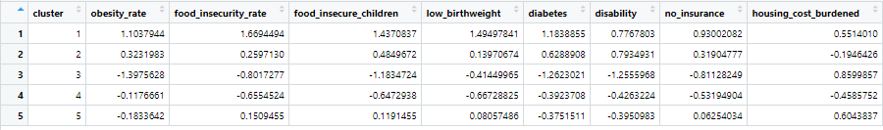
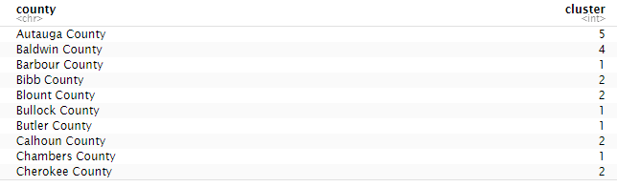
Cluster Analysis w/ Our Data
Now we get to actually run the cluster analysis. Here is a snippet of the cluster means for each variable and which cluster each county falls into.

Slide 8
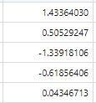
Cluster Analysis w/ Our Data
Before we analyzed what distinguished each cluster, we had to determine what each value even meant.
This was a bit of a tedious process but we decided to create a few rules when describing the values.
If the value is… Here is an example with the values from the variable “below poverty”:
=<-1.0 it is very low 1 - very high levels of poverty
=<-0.5 it is low 2 - high levels of poverty
<0.5 OR >-0.5 it is moderate 3 - very low levels of poverty
=>0.5 it is high 4 - low levels of poverty
=>1.0 it is very high 5 - moderate levels of poverty

Slide 9
Cluster Analysis w/ Our Data
Based on this labeling, we found what made each cluster unique:
Cluster 1: High Health and Financial Vulnerability
Scored Very High/High for prevalence of chronic diseases (obesity, diabetes, low birthweight) + Food Insecurity
Very High/High below poverty, unemployment, housing cost burden, debt rates + Very Low median income and credit score.
Very High people of color population + individuals who had less than college education.
Cluster 2: Moderate-High Vulnerability
Moderate vulnerability across most health and financial issues (moderate obesity rates and food insecurity).
High rates of diabetes, disability, and below poverty.
High senior population and individuals who had less than college education.

Slide 10
Cluster Analysis w/ Our Data
Based on this labeling, we found what made each cluster unique:
Cluster 3: Relatively Stable and Well-Off
Very low/low rates across most health and financial issues (very low obesity rates, low food insecurity rates). + very low rates of individuals who didn’t have a college education and rural population.
High housing cost burden + credit scores
Very High wage market rent and median income
Cluster 4: Moderate Vulnerability with Ethnic Diversity
Moderate/Low rates across most health and financial issues (moderate obesity rates, low food insecurity)
High credit score and people of color population.

Slide 11
Cluster Analysis w/ Our Data
Based on this labeling, we found what made each cluster unique:
Cluster 5: Moderate Vulnerability with a Focus on Children
Moderate rates across almost all variables (moderate levels of obesity and food insecurity)
High housing cost burden, children population
Low senior and people of color population
Very low rural population
Note: We will double check the variables before creating the cluster analysis visualization and maybe utilize a more accurate way analyzing the clusters - since there could be errors when doing such things manually.

Slide 12
02
Mediation Analysis
In determining what statistical test we wanted to conduct, we wanted to try out a mediation analysis.

Slide 13
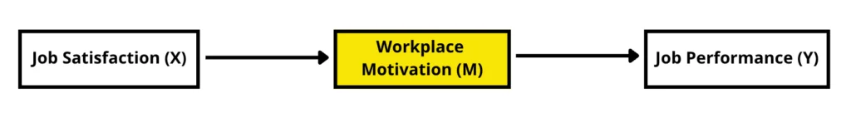
What is mediation analysis?
However, we wanted to understand mediation analysis first…
A statistical technique that helps us understand how an independent variable (X) influences a dependent variable (Y) through a mediator variable (M)
The model above is our example dataset
To interpret the data we will look at 3 types of paths
Direct effects : a (job satisfaction -> workplace motivation), b (workplace motivation -> job performance), c (job satisfaction -> job performance)
Indirect effect : a*b (aka mediated effect)
Total effect: c + indirect effect

Slide 14
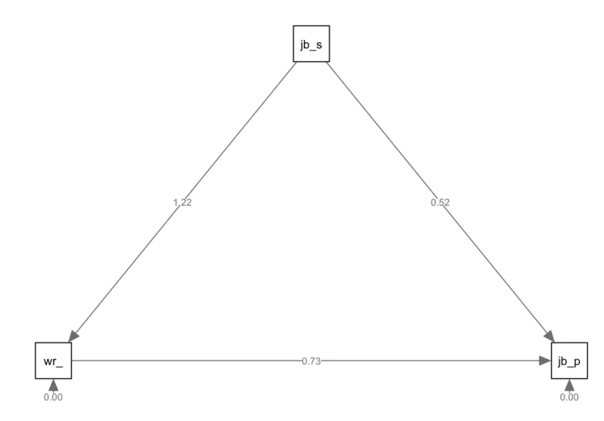
Example
We can recreate this with our data next week.

Slide 15
03
Visualizations
An update from last week.

Slide 16
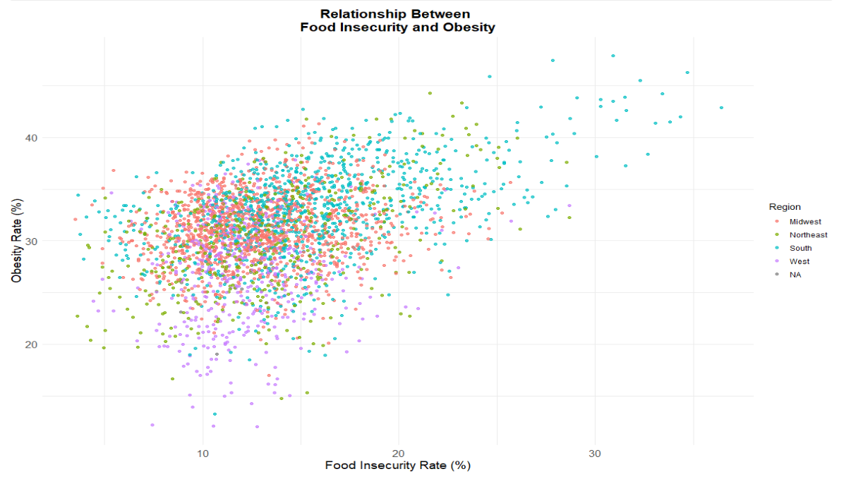
Updated Visual Relationship
Last week, the graph looked like this and the colors weren’t placed correctly:
Notes:
Load the updated rmd on your computer and have the tab with the interactive map in the background so that you could show the class the interactivity during the presentation

Slide 17
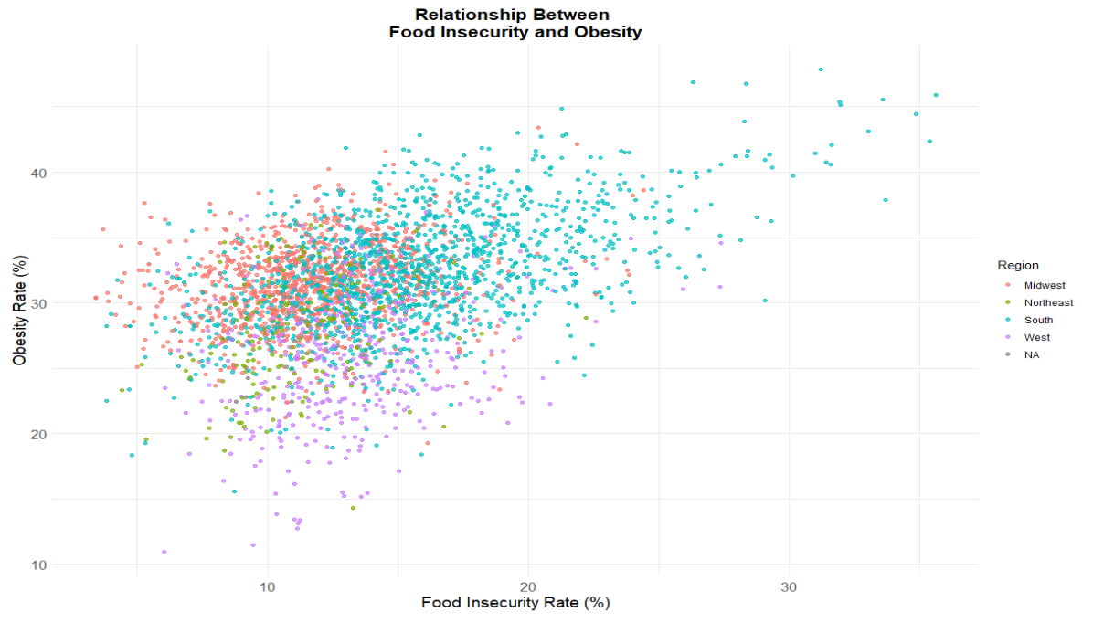
Updated Visual Relationship
We updated the graph to have the correct color-coded regions for each county.
Notes:
Load the updated rmd on your computer and have the tab with the interactive map in the background so that you could show the class the interactivity during the presentation

Slide 18
04
GitHub Update

Slide 19
GitHub Update
We had not previously worked through GitHub, so this week we worked on…
Uploading our work onto our GitHub
Working on making sure that the whole team has access

Slide 20
05
Next Steps

Slide 21
Next Steps
This week we focused heavily on the cluster analysis and mediation analysis. This week we aim to…
Cluster Analysis:
Create the cluster analysis visualization
Mediation Analysis
Run the mediation analysis with our data
Visualizations
Make all our key visualizations accessible through a link
Focus on adding the interactive features that we want
GitHub
Finalize setting up GitHub and all of the other features we need for the final report
Report
Continue working on the report and finish majority of it

